Slide 1
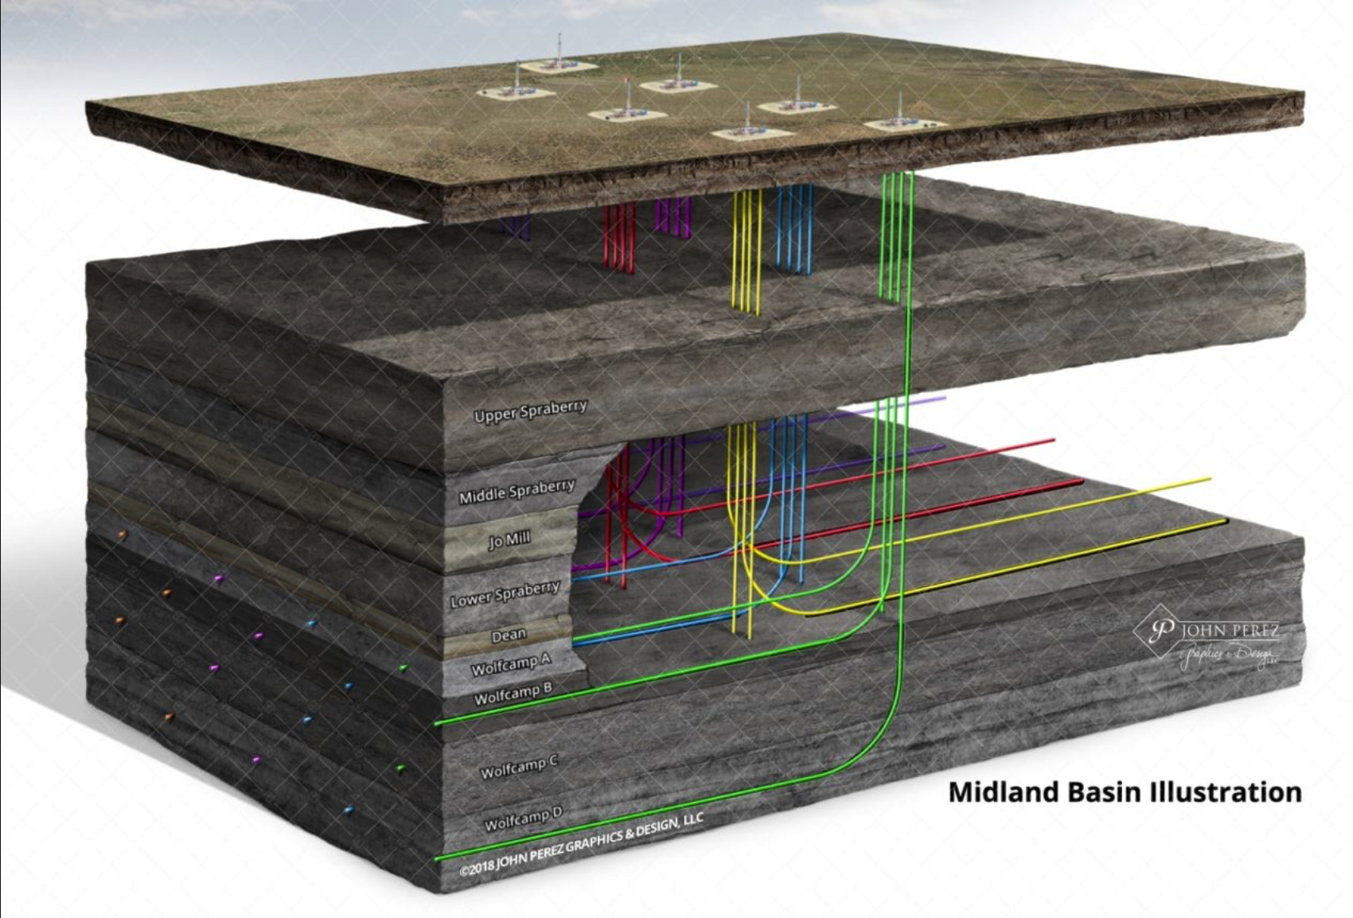
Data Frackin’ Science
Finding Productive Oil Wells in the West Texas Permian Basin
Peter Flaming Matthew Trevathan Quinton Nixon Brock Friedrich

Slide 2
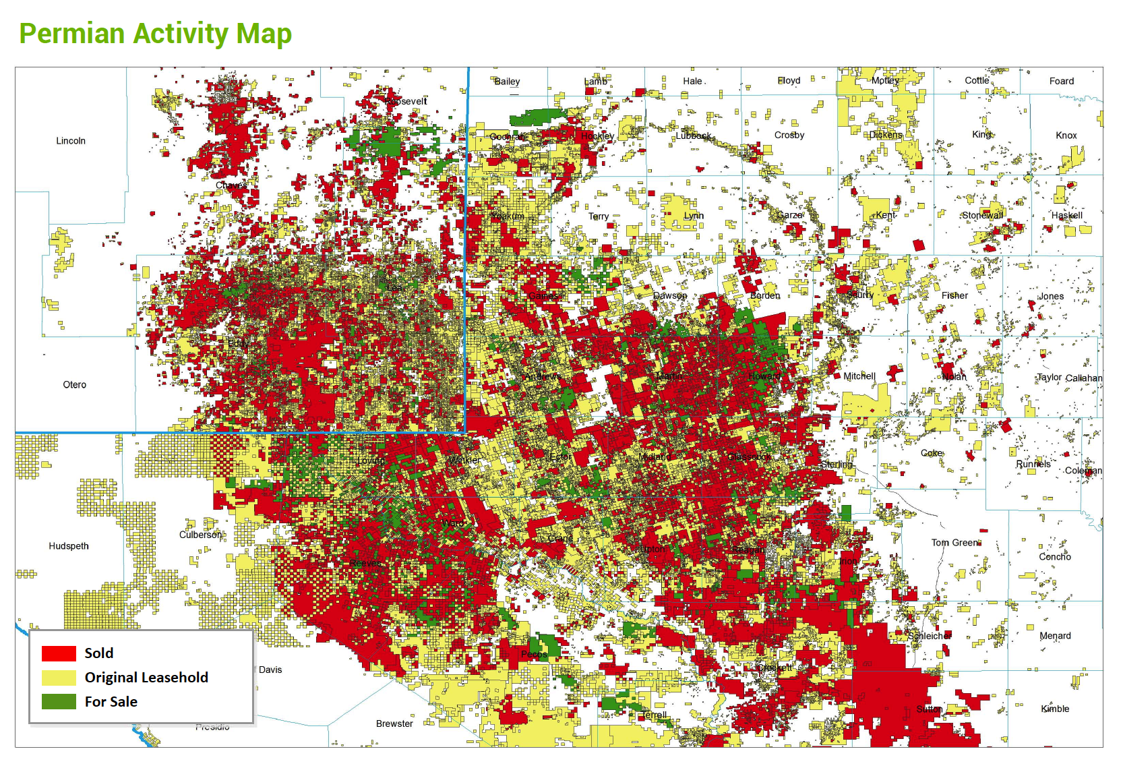
Study Outline
Business Objectives
Data Sourced
Methodology
Evaluation/Results
Summary
Page 2

Slide 3
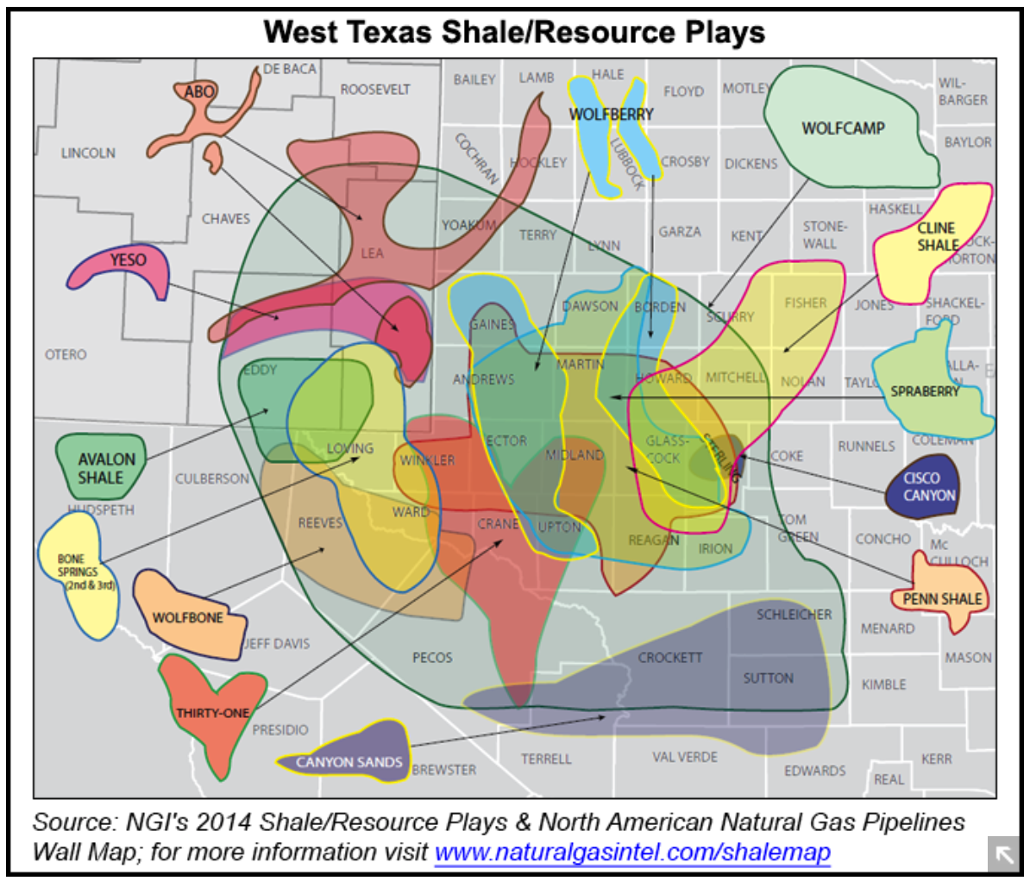
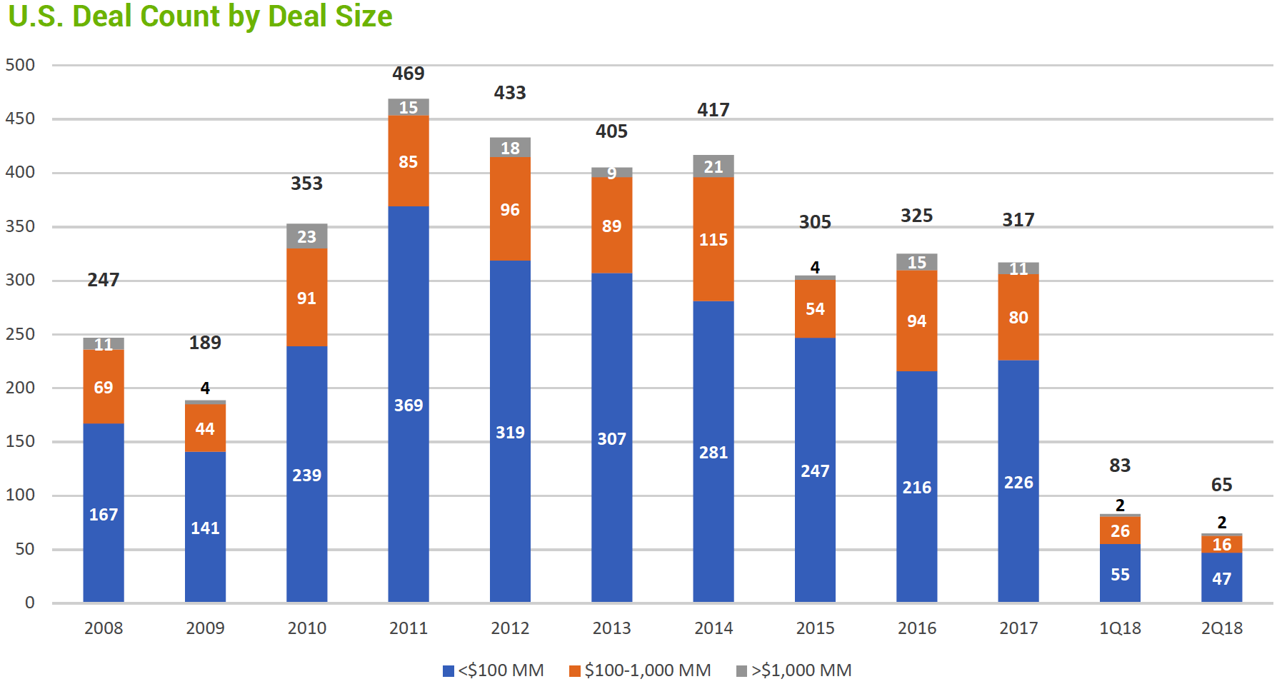
Business Objectives
Find (Cheap) Well Data
Uncover Key Aspects
Produce Quantified Results
Determine Linear Trends
Determine Top Plays
Market Overview
Where to deal and what to play?
Page 3

Slide 4
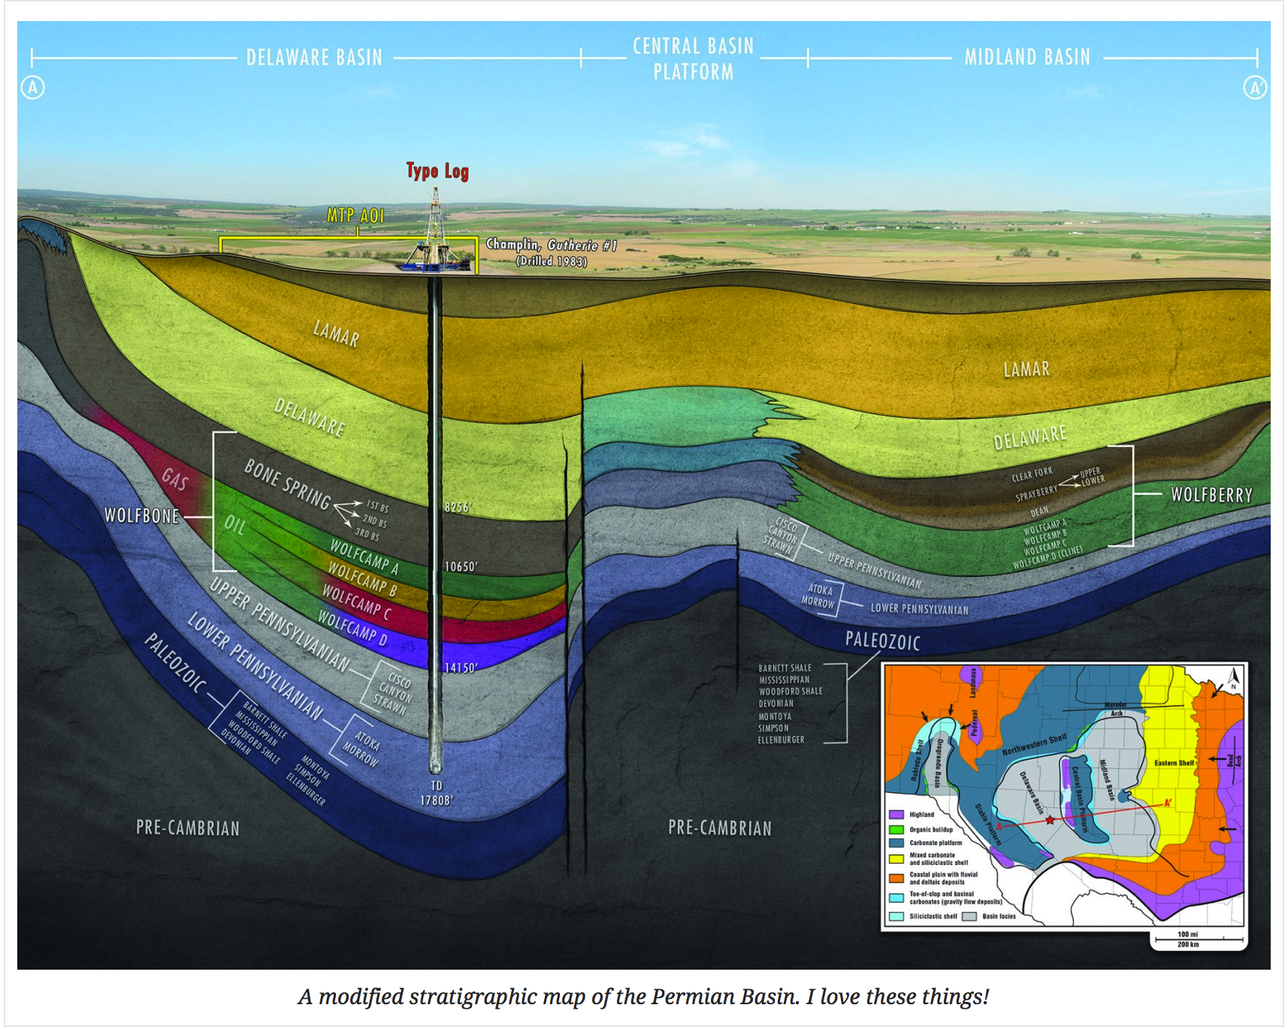
Research Questions
Questions
Does well productivity increase with 'frac size’?
How does it increase?
Are there regional trends?
Trends by formation?
Do additives affect oil productivity?
Page 4

Slide 5
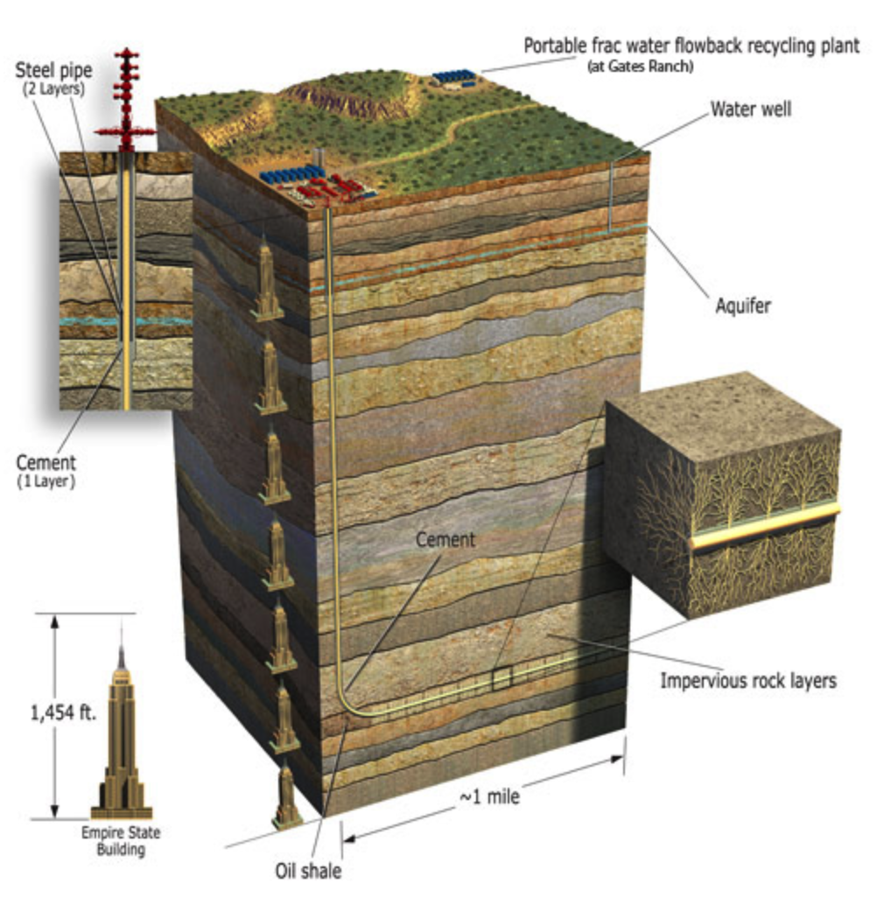
Data Source
Data
Driftwood
fracfocus.org
1,454ft x 5 = ~7300ft =
TVD
Quantify Everything!
Page 5

Slide 6
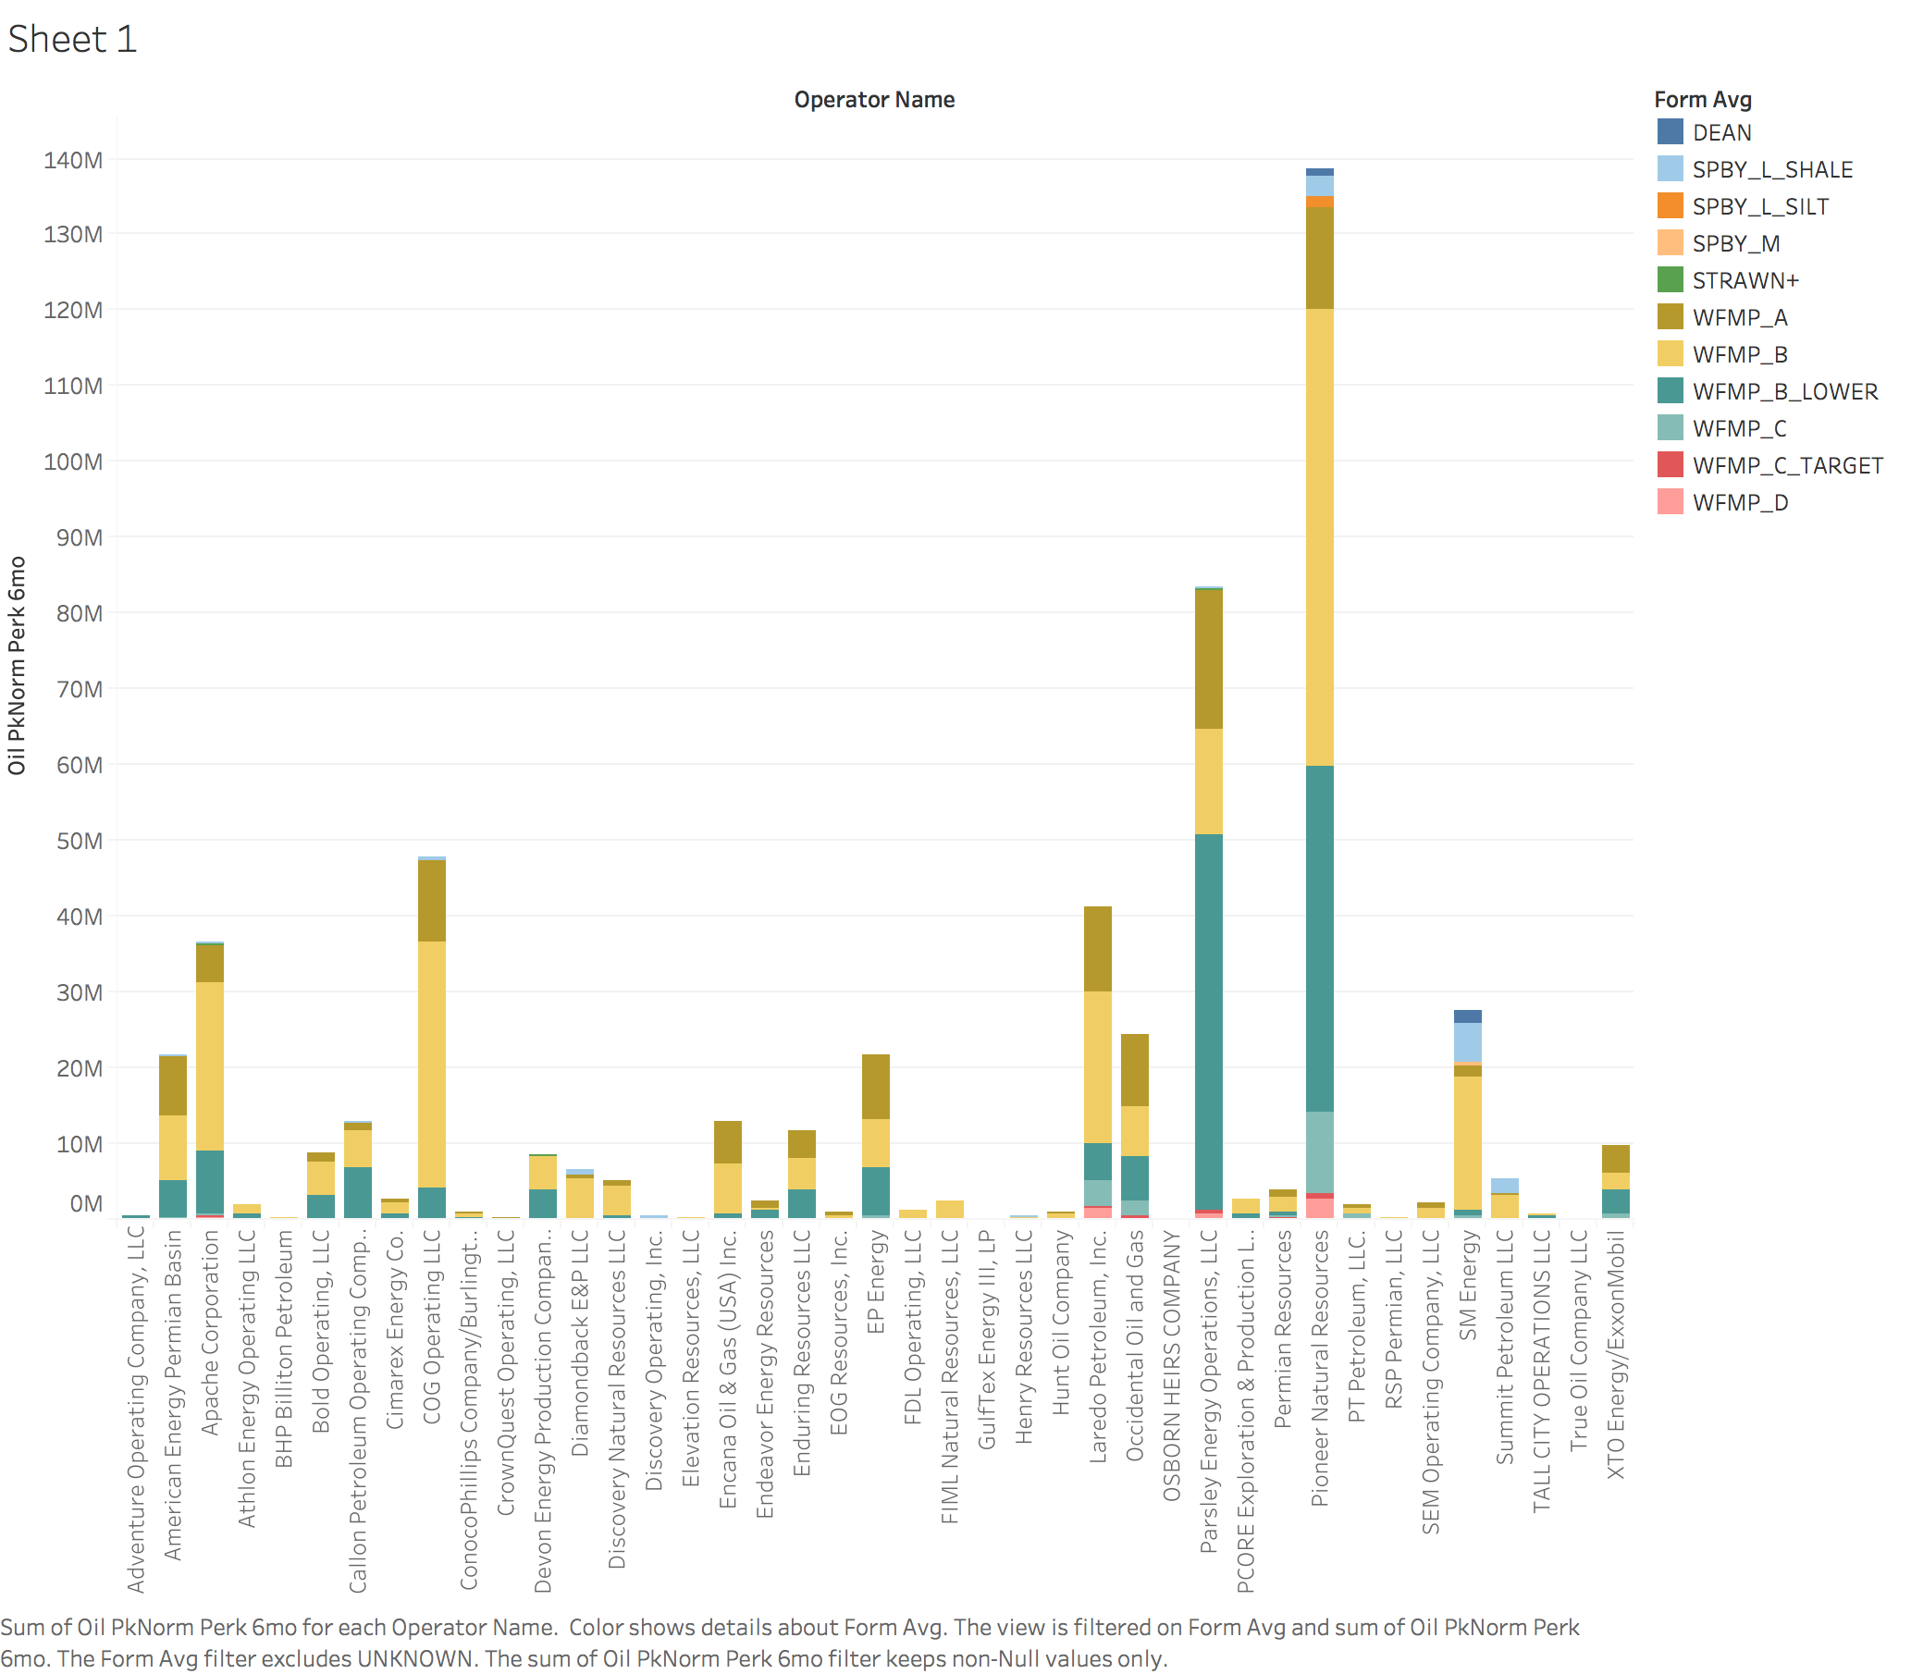
Exploratory Data Analysis
Oil Production by Company
Page 6

Slide 7
Methodology
Steps
Step 1
Step 2
Step 3
Workflow
Step 1
Step 2
Step 3
Page 7
Notes:
Brock
Understand significance of ABV and IBU relationship

Slide 8
Evaluation and Results
Tell me the percentages and why
Show me graphs with explanations
Was your hypothesis correct
Provide any other interesting trends and observations from your analysis
Other things to consider?
Page 8
Notes:
Quinton

Slide 9
Summary
Insights
Recommendations
Improvements
Page 9

Slide 10
Questions
Page 10

